Slide 1
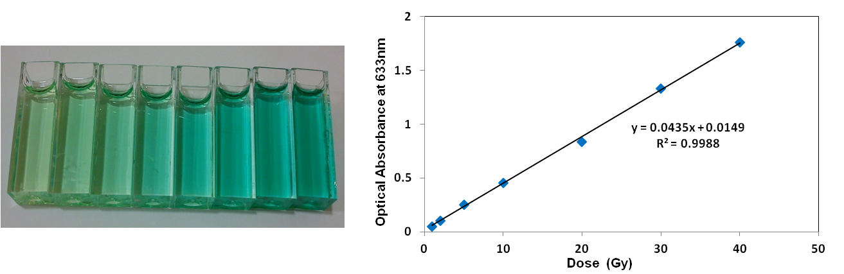
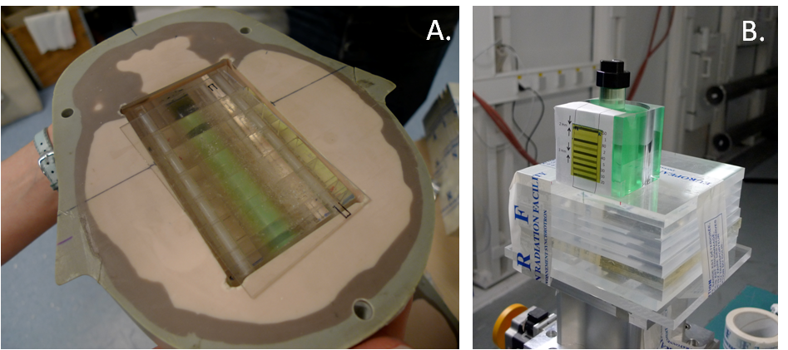
b.
a.
Notes:
EJMP paper

Slide 2
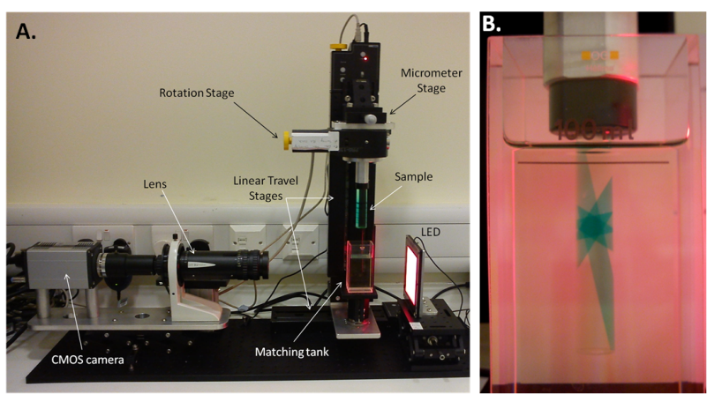
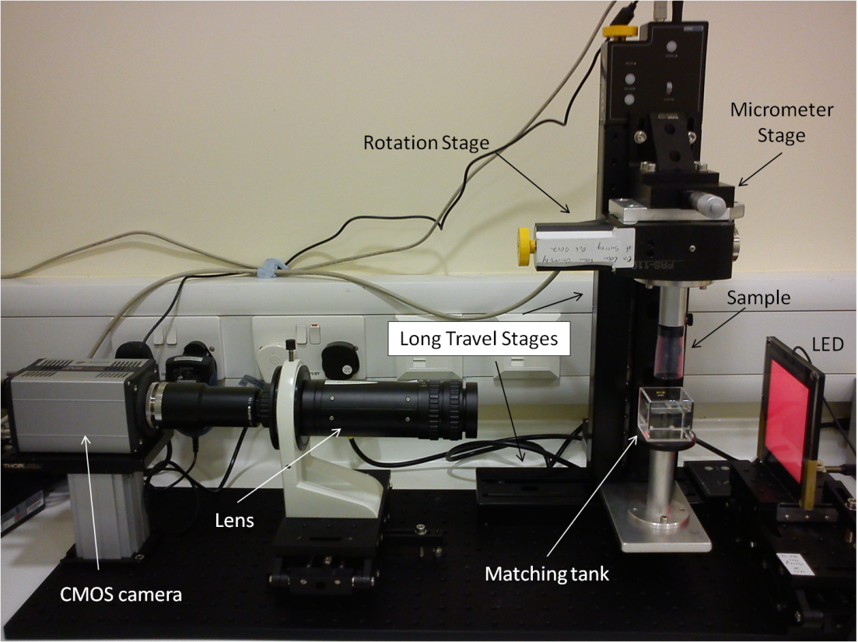
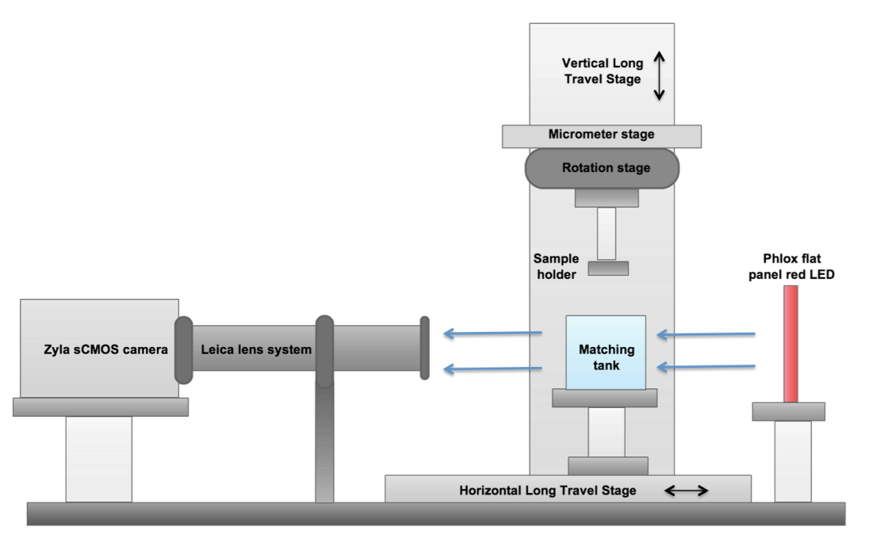

Slide 3
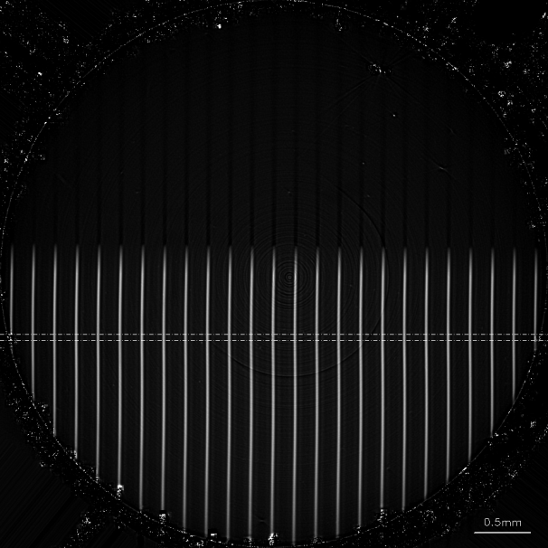

Slide 4
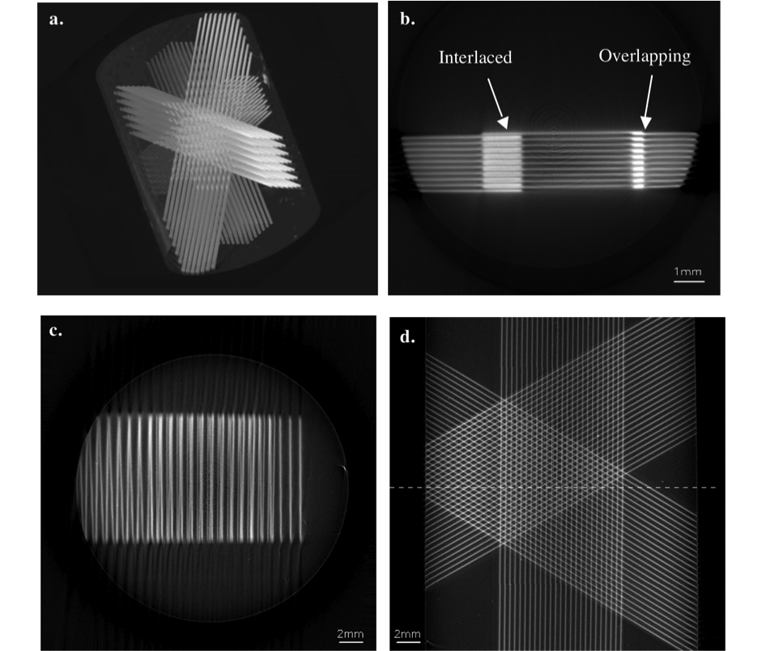

Slide 5
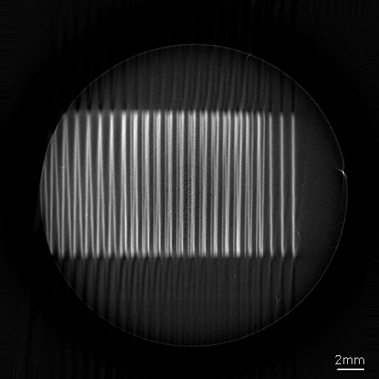
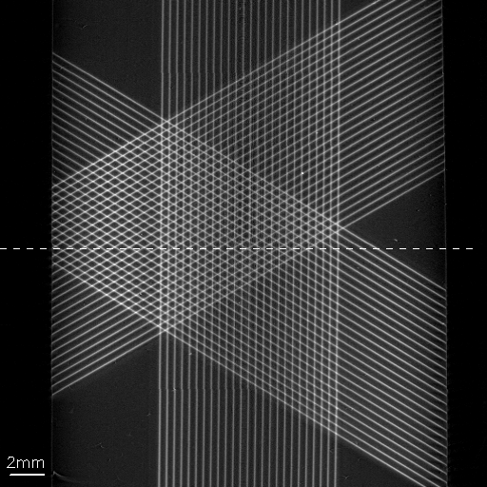

Slide 6
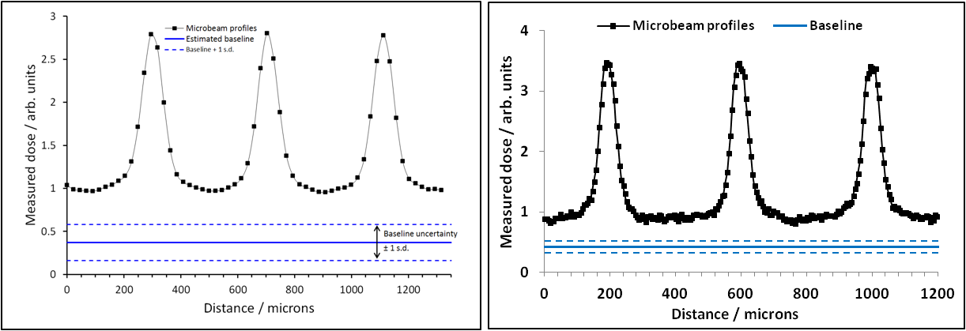
Notes:
EJMP paper

Slide 9
Peak
Valley
a.
b.

Slide 10
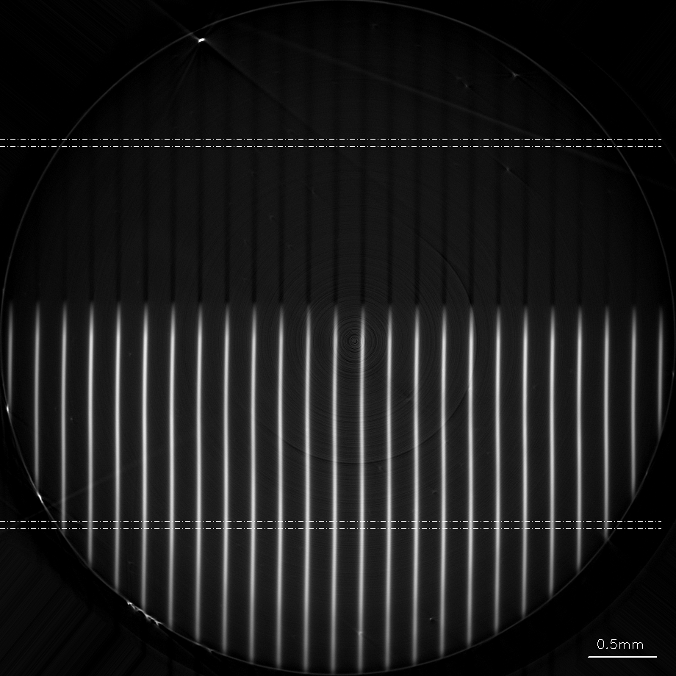

Slide 11
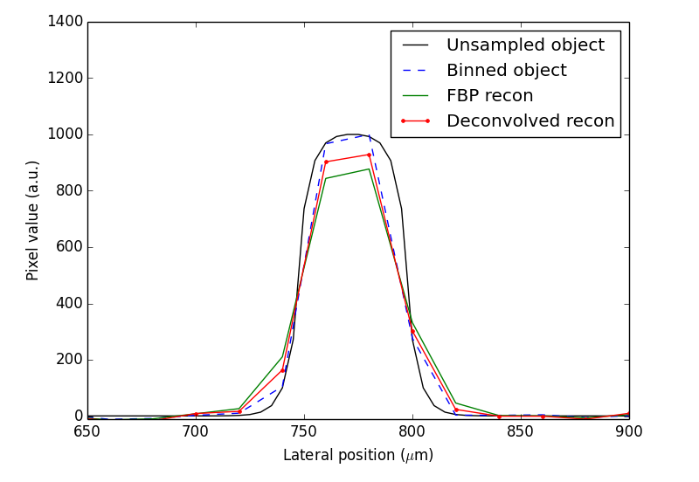

Slide 12
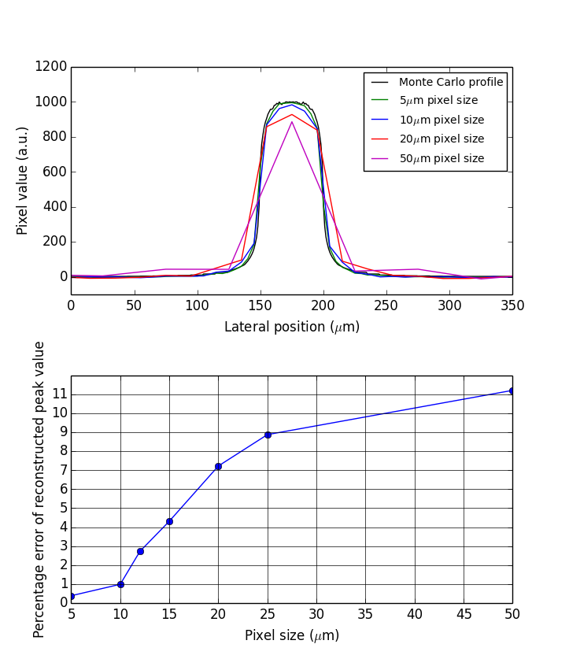
# -*- coding: utf-8 -*-
"""
Created on Mon Oct 06 16:59:41 2014
@author: cmcerlean
"""
import numpy as np
import matplotlib.pyplot as plt
#from scipy import misc
#import scipy.ndimage as scip
import pylab
from skimage.transform import iradon
from array_binning import congrid #rebin
from skimage import util
from skimage.transform._warps_cy import _warp_fast
#from scipy import stats
#import Image
import cv2 # OpenCV is used
def RL_deconvolution(observed, psf, iterations):
# initial estimate is arbitrary - uniform 50% grey works fine
latent_est = 0.5*np.ones(observed.shape)
# create an inverse psf
psf_hat = psf[::-1,::-1]
# iterate towards ML estimate for the latent image
for i in np.arange(iterations):
est_conv = cv2.filter2D(latent_est,-1,psf)
relative_blur = observed/est_conv;
error_est = cv2.filter2D(relative_blur,-1,psf_hat)
latent_est = latent_est * error_est
return latent_est
def sector_mask(shape,centre,radius):
"""
Return a boolean mask for a circular sector. The start/stop angles in
`angle_range` should be given in clockwise order.
"""
x,y = np.ogrid[:shape[0],:shape[1]]
cx,cy = centre
# convert cartesian --> polar coordinates
r2 = (x-cx)*(x-cx) + (y-cy)*(y-cy)
# circular mask
circmask = r2 <= radius*radius
return circmask
def optical_blur(image, Lens_PSF):
imagesize = image.shape[0]
PSFsize = Lens_PSF.shape[0]
PSF = Lens_PSF
#congrid(Lens_PSF, (imagesize,imagesize), method='linear',
# centre=False, minusone=False)
# resize image to next power of two (but no less than 64) for
# Fourier analysis; speeds up Fourier and lessens artifacts
object_size_padded = max(64, int(2**np.ceil(np.log2(2 * imagesize))))
pad_width = ((0, object_size_padded - imagesize),
(0, object_size_padded - imagesize))
PSFpad_width = ((0, object_size_padded - PSFsize),
(0, object_size_padded - PSFsize))
imagepadded = util.pad(image, pad_width, mode='constant',constant_values=0)
PSFpadded = util.pad(PSF,PSFpad_width, mode='constant',constant_values=0)
blurredpadded = np.real(np.fft.ifft((np.fft.fft(PSFpadded))*
(np.fft.fft(imagepadded))))
blurred = blurredpadded[:imagesize, :imagesize]
return blurred
def sino_maker(image, nProj):
theta = 180*np.arange(nProj)/np.float(nProj)
diagonal = np.sqrt(2)*max(image.shape)
pad = [int(np.ceil(diagonal - s)) for s in image.shape]
new_centre = [(s+p)//2 for s,p in zip(image.shape, pad)]
old_centre = [s//2 for s in image.shape]
pad_before = [nc - oc for oc, nc in zip(old_centre, new_centre)]
pad_width = [(pb, p-pb) for pb, p in zip(pad_before, pad)]
padded_image = util.pad(image, pad_width,
mode='constant', constant_values = 0)
assert padded_image.shape[0] == padded_image.shape[1]
radon_image = np.zeros((padded_image.shape[0], len(theta)))
centre = padded_image.shape[0]//2
shift0 = np.array([[1,0,-centre],[0,1,-centre],[0,0,1]])
shift1 = np.array([[1,0,centre],[0,1,centre],[0,0,1]])
def build_rot(theta):
T = np.deg2rad(theta)
R = np.array([[np.cos(T), np.sin(T), 0], [-np.sin(T),
np.cos(T), 0], [0,0,1]])
return shift1.dot(R).dot(shift0)
for i in range(nProj):
rotated = _warp_fast(padded_image, build_rot(theta[i]))
radon_image[:,i] = rotated.sum(0)
return radon_image
def MRT_MC_sim_object_maker(FOV, peak):
file = open('MRT_MC_onebeam50micron.dat') #load single MC sim of 50um peak, pix size 1um
data = np.loadtxt(file, delimiter='\t')
single_peak = data[19800:20200] #take central 400um
npeaks = np.ceil(FOV/400.0)
profile = np.tile(single_peak,(FOV, npeaks)) #expand over desired no of peaks
im = profile[0:FOV, 0:FOV] #crop to desired FOV
crc = sector_mask(im.shape, (0.5*FOV, 0.5*FOV), 0.5*FOV) #add circ mask and peak
im = im*peak*crc
return im
def MRT_object_maker(FOV, pixsize, fwhm, ctc,peak, baseline, noise):
#Make object @ object_pixel_size
sz = FOV/pixsize
c = ctc/pixsize
fpix = fwhm/pixsize
im = baseline*np.ones((sz,sz), dtype = 'd')
for i in range(FOV/ctc):
im[0:(0.5*sz),(c-fpix):c] = peak
c = c + ctc/pixsize
#Convolve with exp to get MRT beam shape (sort of)
nx = np.arange(sz) - sz/2.0
for i in range(sz):
im[i,:] = np.fft.ifft((np.fft.fft(im[i,:])*
(np.fft.fft(np.nan_to_num(np.exp(abs(nx)))))))
crc = sector_mask(im.shape, (0.5*sz, 0.5*sz), 0.5*sz)
im = ((im*peak)/(np.max(im)))*crc
if (noise != 0):
im += np.random.poisson(noise,im.shape).astype(float) - noise
return im
FOV = 1500 #in um
obpixelsize = 1 #in um
#sample_pixelsize = 10
ctc = 400
fwhm = 50
baseline = 1
peak = 1000.0 #In Gy
noise = 0
valley_width = 3
no_peaks = FOV/ctc - 1
sampsizes = [5,10,12,15,20,25,50]
nsamps = len(sampsizes)
#im = MRT_object_maker(FOV, obpixelsize, fwhm, ctc, peak, baseline, noise)
im = MRT_MC_sim_object_maker(FOV, peak)
obim = np.copy(im) #keep a copy of large matrix sample
binned_ims = []
recon_ims = []
true_peak = np.zeros_like(sampsizes, dtype=np.float)
binned_peak = np.zeros_like(sampsizes, dtype=np.float)
recon_peak = np.zeros_like(sampsizes, dtype=np.float)
for i in range(nsamps):
x = FOV/sampsizes[i]
scl = sampsizes[i]/obpixelsize
nProj = int(np.ceil(0.5*(np.pi)*x))
phi = 180.0/nProj
im = congrid(obim, (x,x), method='linear', centre=False, minusone=False)
recon = iradon(sino_maker(im, nProj), output_size=x, filter ='ramp')#shepp-logan')
binned_ims.append(im)
r = np.copy(recon)
recon_ims.append(recon)
true_peak[i] = np.max(obim[0.4*FOV/obpixelsize, :])
binned_peak[i] = np.max(im[0.4*x, :])
recon_peak[i] = np.max(recon[0.4*x, :])
#Plots---------------------------------------------------------------------------------
cmap=pylab.gray()
plt.close('all')
f1, ax1 = plt.subplots(1,3,figsize=(15,5), num = 1)
ax1[0].imshow(obim, cmap=cmap)
ax1[1].imshow(binned_ims[nsamps-1],cmap=cmap)
ax1[2].imshow(recon_ims[nsamps-1],cmap=cmap)
ax1[0].set_title('Unsampled Object')
ax1[1].set_title('Binned Object')
ax1[2].set_title('Reconstruction')
#ax2[2].plot(vmeans)
f2, ax2 = plt.subplots(3,1,num = 2,figsize=(8,10))
obdisp = np.arange(0, FOV, obpixelsize)
sampdisp = np.arange(0, FOV, sampsizes[nsamps-1])
ax2[0].plot(obdisp,obim[0.4*FOV/obpixelsize, :],'-k',label='Unsampled object')
ax2[0].plot(sampdisp, im[0.4*x, :],'--b', label='Binned object ' )
ax2[0].plot(sampdisp, recon[0.4*x, :], 'g', label='FBP recon')
for i in range(1):
ax2[i].set_ylim([-100,1500]) #peak+200
#axs[i].set_xlim([650,1300])#FOV])
ax2[i].set_xlabel('Lateral position ($\mu$m)' )
ax2[i].set_ylabel('Pixel value (a.u.)')
ax2[0].legend()
peaks = np.arange(no_peaks-1)
colours = ['g','b','r','m','c','y','-k']
ax2[1].plot(sampsizes, true_peak, '--ok')
ax2[1].plot(sampsizes, binned_peak, '--vb')
ax2[1].plot(sampsizes, recon_peak, '--sg')
ax2[2].plot(sampsizes, (true_peak-recon_peak)/true_peak, '-o')
psamp = [0,1,4,6]
f3, ax3 = plt.subplots(2,1,num = 3,figsize=(10,15))
ax3[0].plot(obdisp -425 ,obim[0.4*FOV/obpixelsize, :],'k',label='Monte Carlo profile')
for j in range(len(psamp)):
i = psamp[j]
r_img = recon_ims[i]
x = FOV/sampsizes[i]
ax3[0].plot(np.arange(0,FOV,sampsizes[i]) - 425, r_img[0.4*x,:],colours[j], label= str(sampsizes[i])+'$\mu$m pixel size')
ax3[0].set_ylim([-100,1200])
ax3[0].set_xlim([0,350])
ax3[0].set_xlabel('Lateral position ($\mu$m)' )
ax3[0].set_ylabel('Pixel value (a.u.)')
#ax3[0].legend(bbox_to_anchor=(1.05, 1), loc=2, borderaxespad=0.)
ax3[0].legend(prop={'size':10})
p_error = 100*(true_peak-recon_peak)/true_peak
ax3[1].plot(sampsizes, p_error, '-ob')
ax3[1].set_xlabel('Pixel size ($\mu$m)')
ax3[1].set_ylabel('Percentage error of reconstructed peak value')
#ax3[1].set_xlim([5,25])
#ax3[1].minorticks_on()
ax3[1].set_yticks(range(12))
#ax3[1].set_yticks(range(12))
#ax3[1].grid(b = True, which = 'minor', color='k', linestyle='-')
ax3[1].grid(b = True, which = 'major', color='k', linestyle='-')
plt.tight_layout
a.
b.
Notes:
Using 50um MC simulated beam

Slide 13
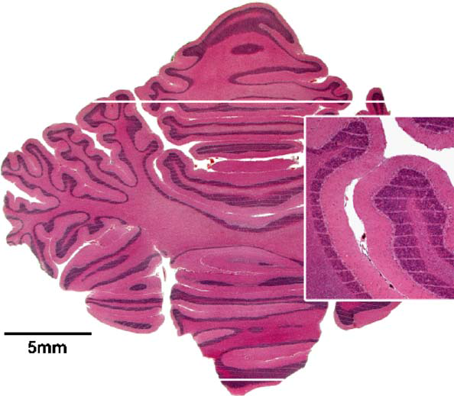
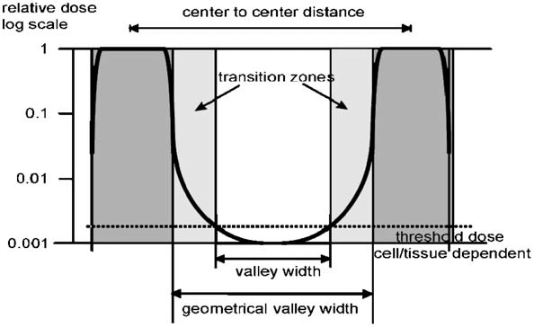
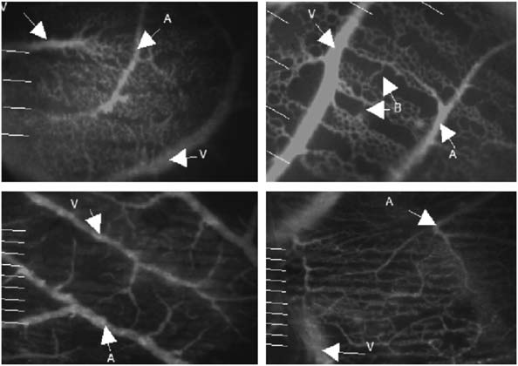
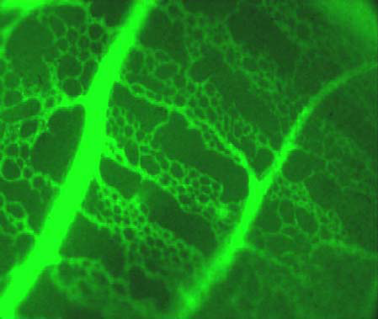
Fig. 1. Horizontal section of the cerebellum of a piglet of 15months after irradiation with a skin entrance dose of 300 Gy.Some cells and their nuclei directly in the path of microbeams
were destroyed. There was no tissue destruction present, norwere there signs of hemorrhage. The paths of the microbeamsappear in the section as thin, white horizontal parallel stripes,which are more easily visible in the insert. Beam width 27 µm,210 µm.
Fig. 2. Schematic dose profile between two microbeams, with the different characteristic areas of the peak, the transition zone and the valley.
Fig. 4. CAM’s irradiated with 300 and 600 Gy. Beam width27 mm beam separation 210 mm. White lines indicate locationsof microbeam planes, v ¼ vein, a ¼ artery, b ¼ bridge upper
row 300 Gy, 2 h (left) and 24 h (right) after irradiation, lower row 600 Gy, 2 h (left) and 24 h (right) after irradiation.
Siegbahn
Notes:
H. Blattmann et al. / Nuclear Instruments and Methods in Physics Research A 548 (2005) 17–22 21
Fig1 actually from Laissue 2001

Slide 14
a.
b.

Slide 15
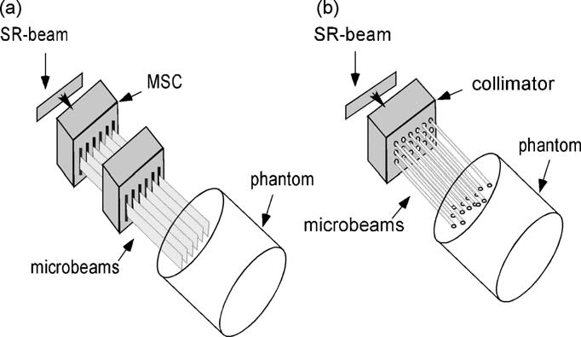
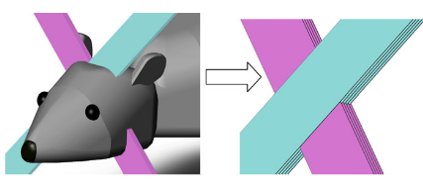
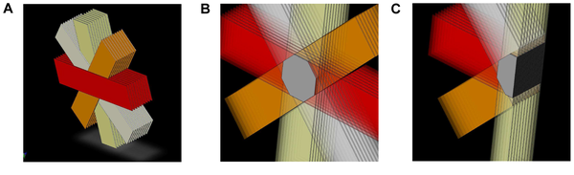
A Siegbahn et al., Med. Phys., 33(9), (2006) 3248
B Bräuer-Krisch et al., Phys. Med. Biol. 50 (2005) 3103–3111
C Serduc, Bräuer-Krisch et al. PLoS ONE 5(2) (2010)
a.
b.
c.

Slide 16
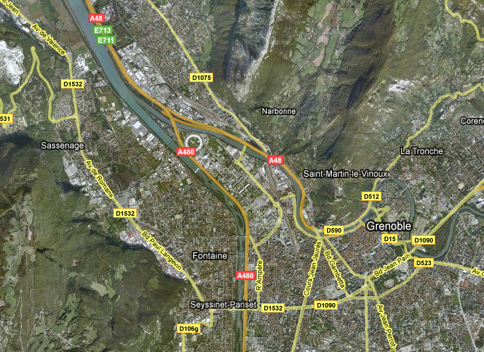
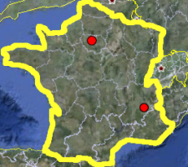
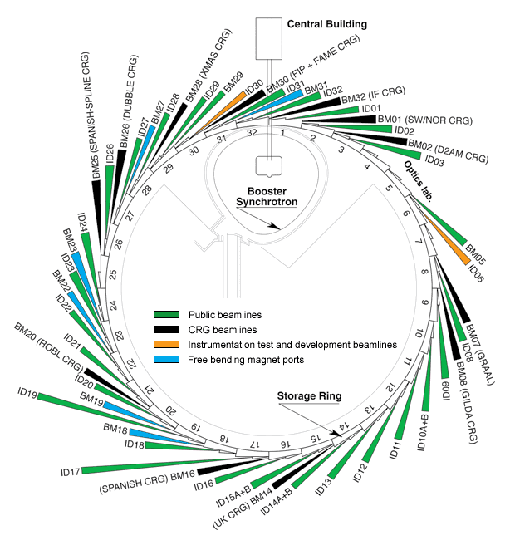
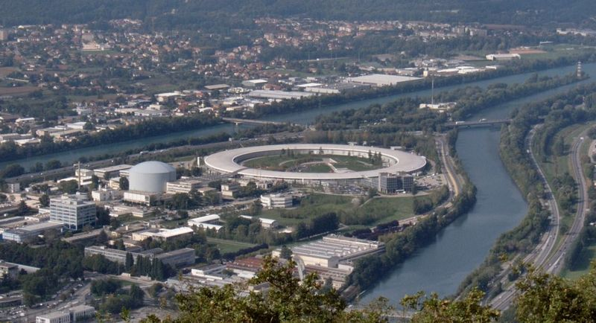
Paris

Slide 17
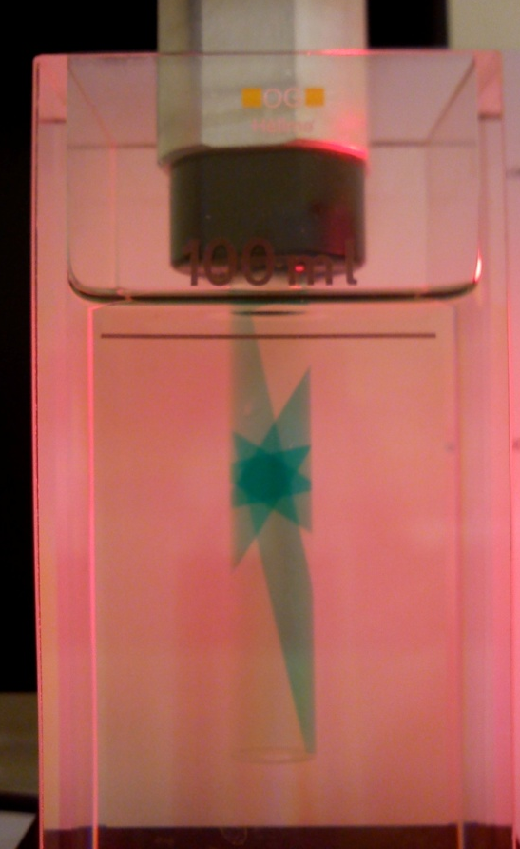
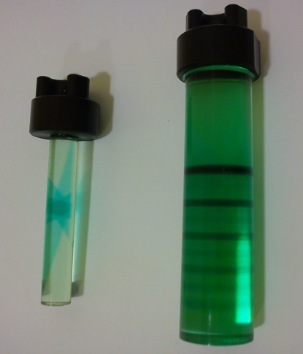
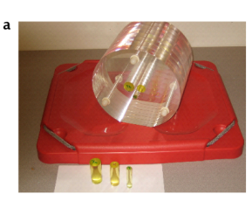


Slide 18
CT scan
Treatment Planning
Positioning
Delivery

Slide 19
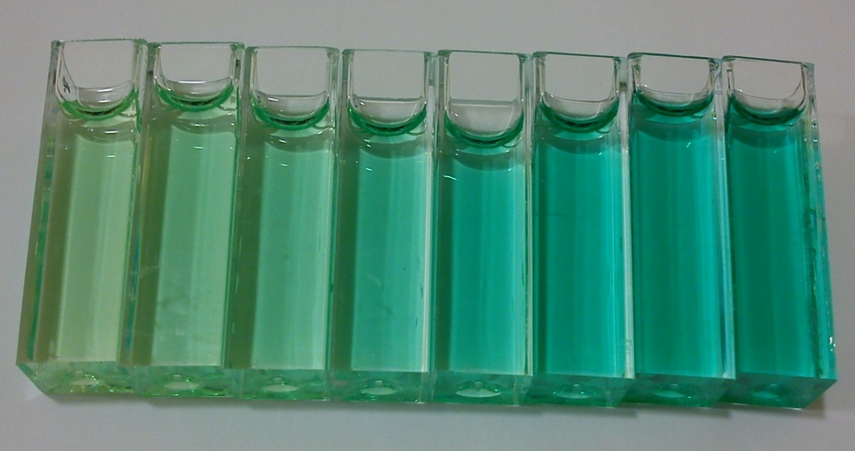
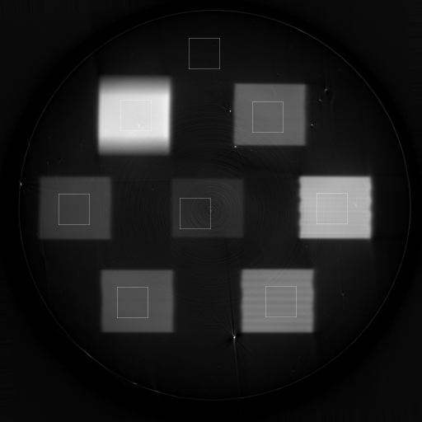
a.
b.
c.
d.

Slide 20
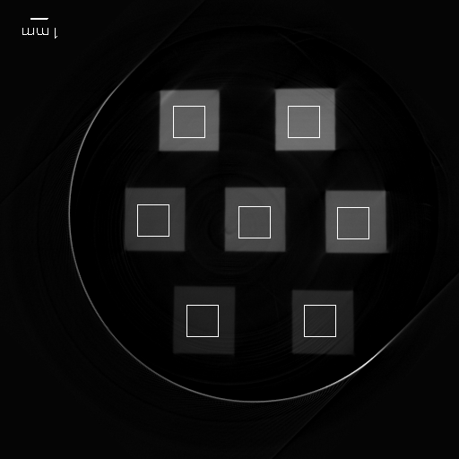
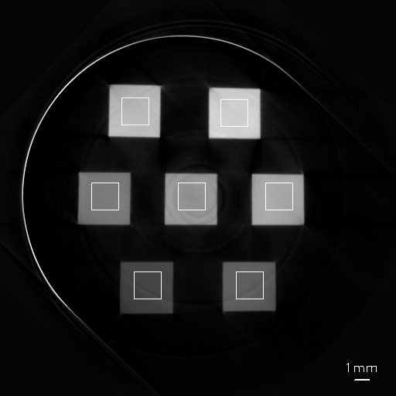
a.
b.
c.
d.
e.

